Slide 1
Pyspark

Slide 2
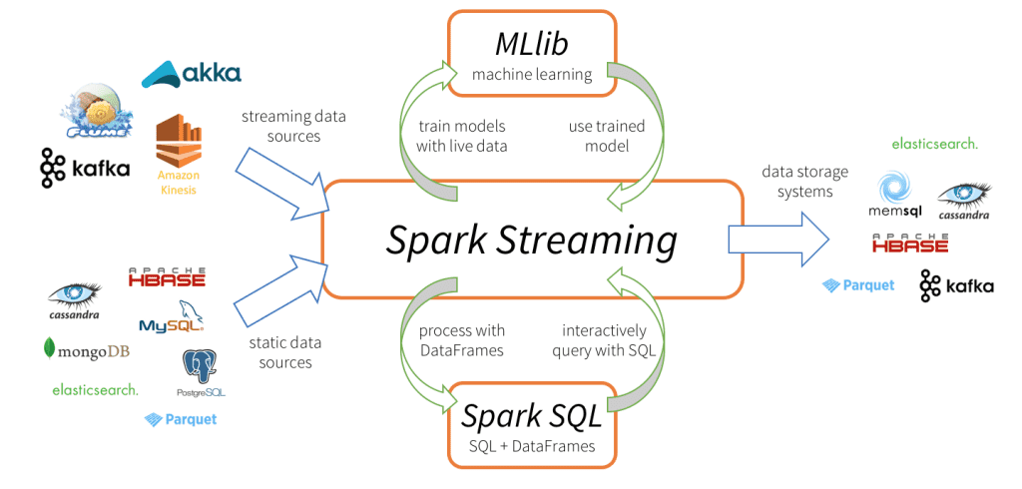

Slide 3


Slide 4
Apache Spark Features

Slide 5
Polyglot
Speed
Powerful
Caching
Deployment
Real-Time
Fault tolerance
Rich libraries
Reusability
Dynamic in nature
Memory computation
Advanced analytics
Scalable

Slide 6
Terminologies of spark

Slide 7
Driver Program
Data Frame
Working of Partitions Engine
Cluster Manager
Worker Node
MLib
GraphX
Task
Spark Session
Spark Context
Datasets
Stage
Pipelines
Application
Spark Streaming
Spark SQL
Executor
Lazy Evaluation
Core
On-heap memory
Off-heap memory

Slide 8
Libraries
Languages
SQL Streaming ML Lib Graphx
Scala Java Python SQL R

Slide 9
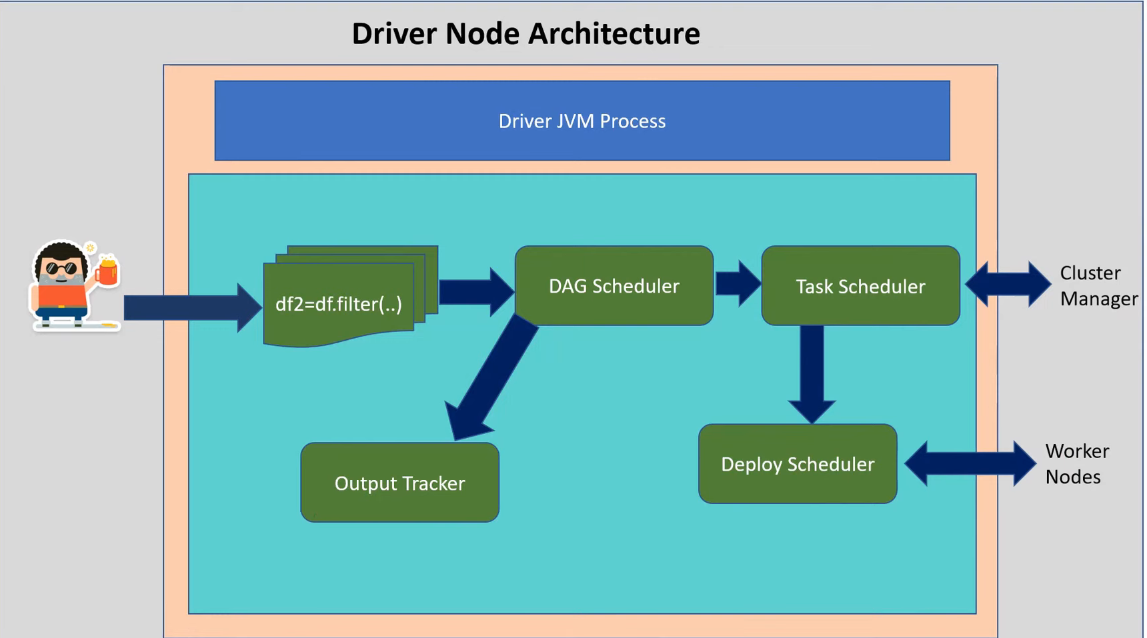

Slide 10
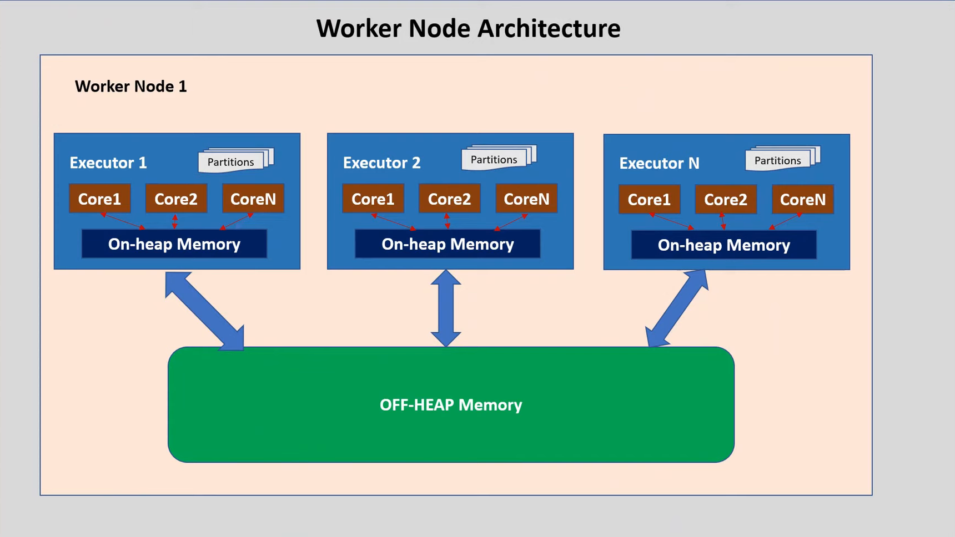

Slide 11
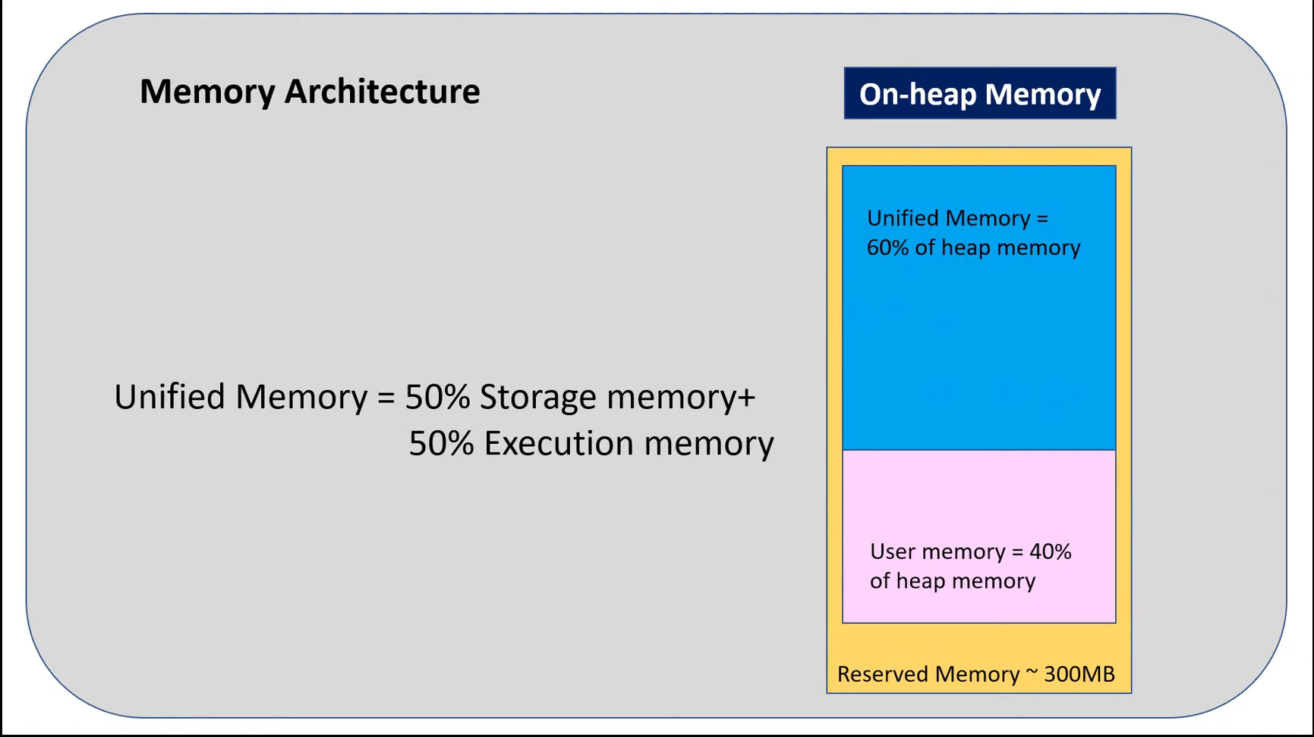

Slide 12
PySpark Read CSV file into DataFrame
from pyspark.sql import SparkSession
spark = SparkSession.builder.appName('Read Multiple CSV Files').getOrCreate()
path = ['/content/authors.csv','/content/book_author.csv']
files = spark.read.csv(path, sep=',’, inferSchema=True, header=True)

Slide 13
PySpark: RDD, DataFrame and Dataset

Slide 14
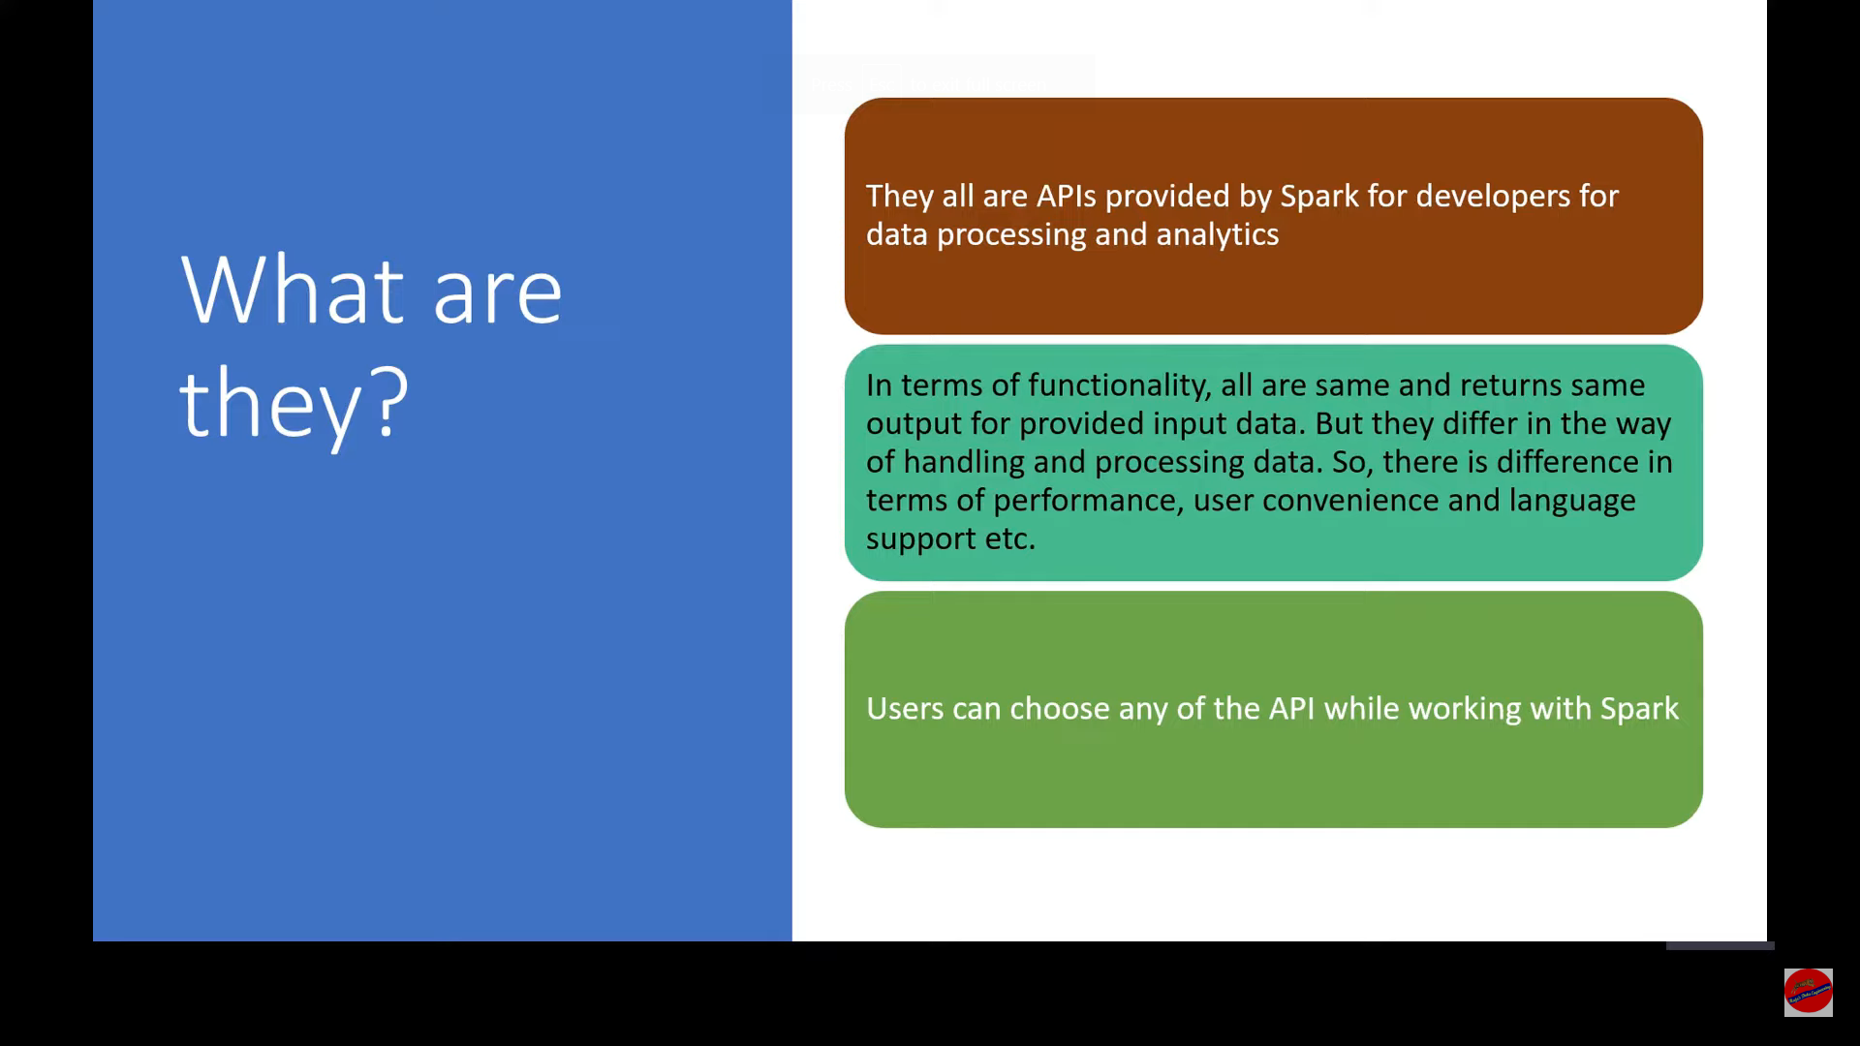

Slide 15
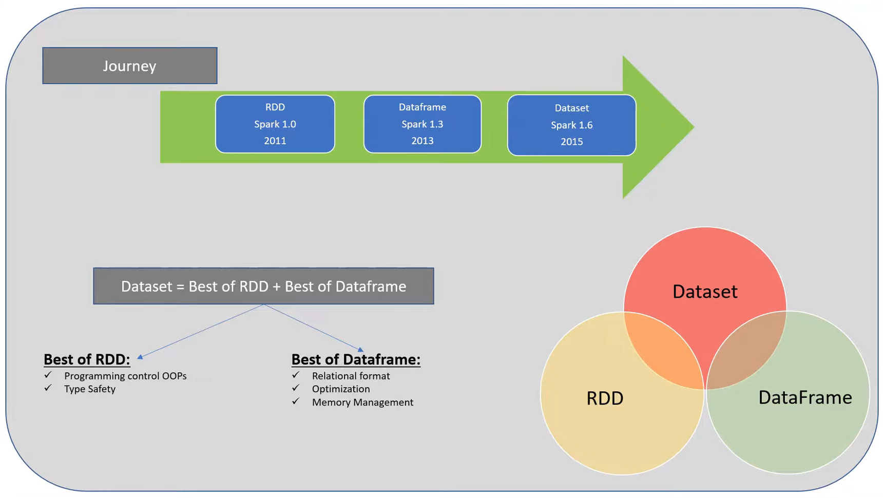

Slide 16
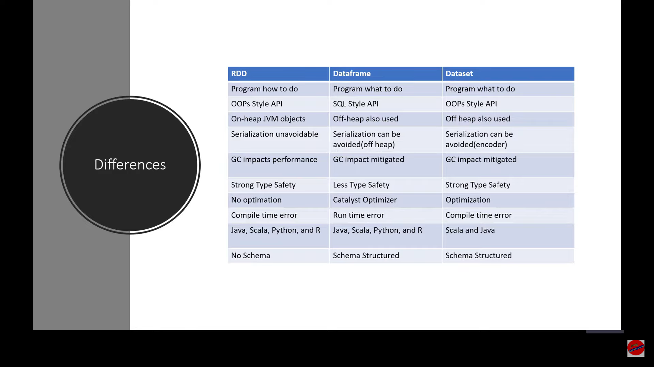

Slide 17
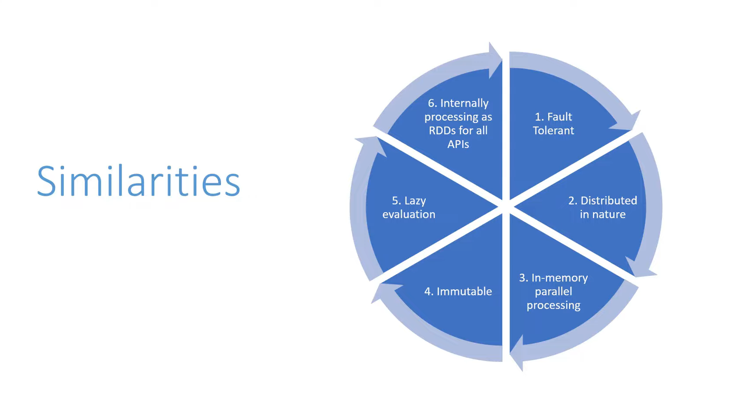

Slide 18
PySpark: Transformation and Action

Slide 19
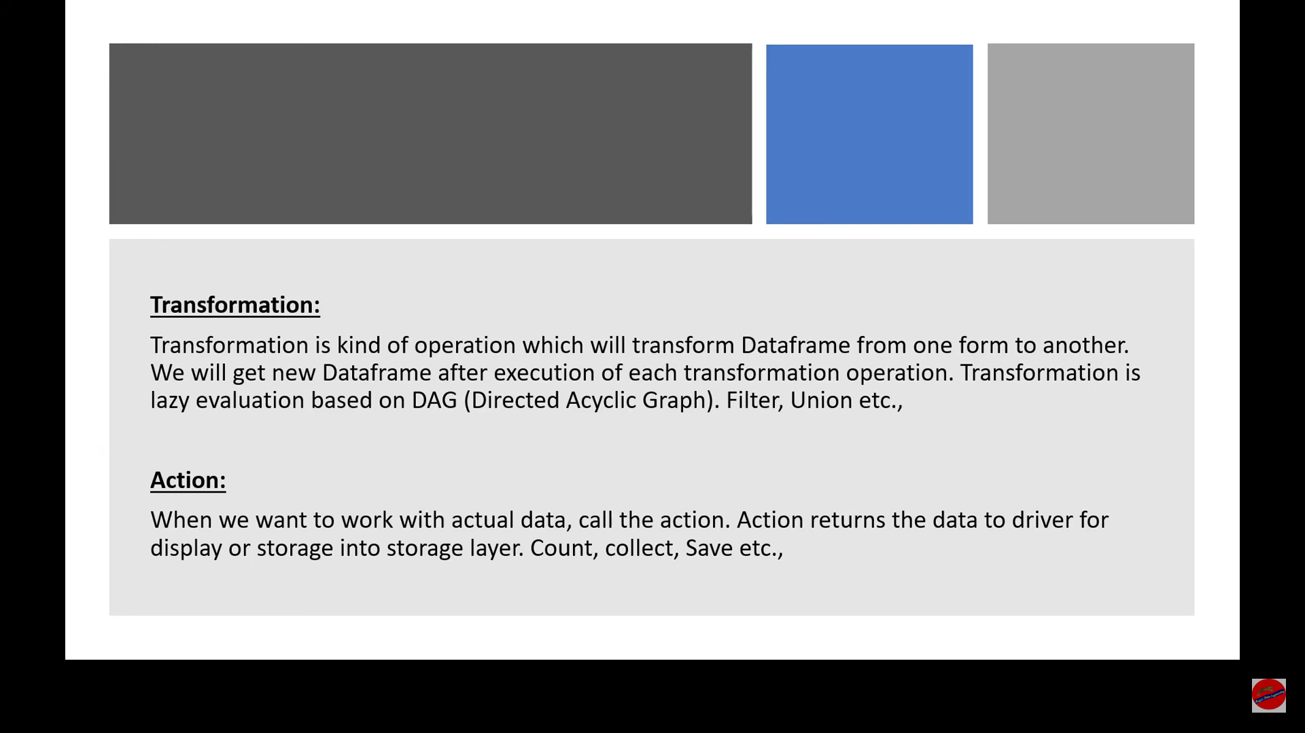

Slide 20
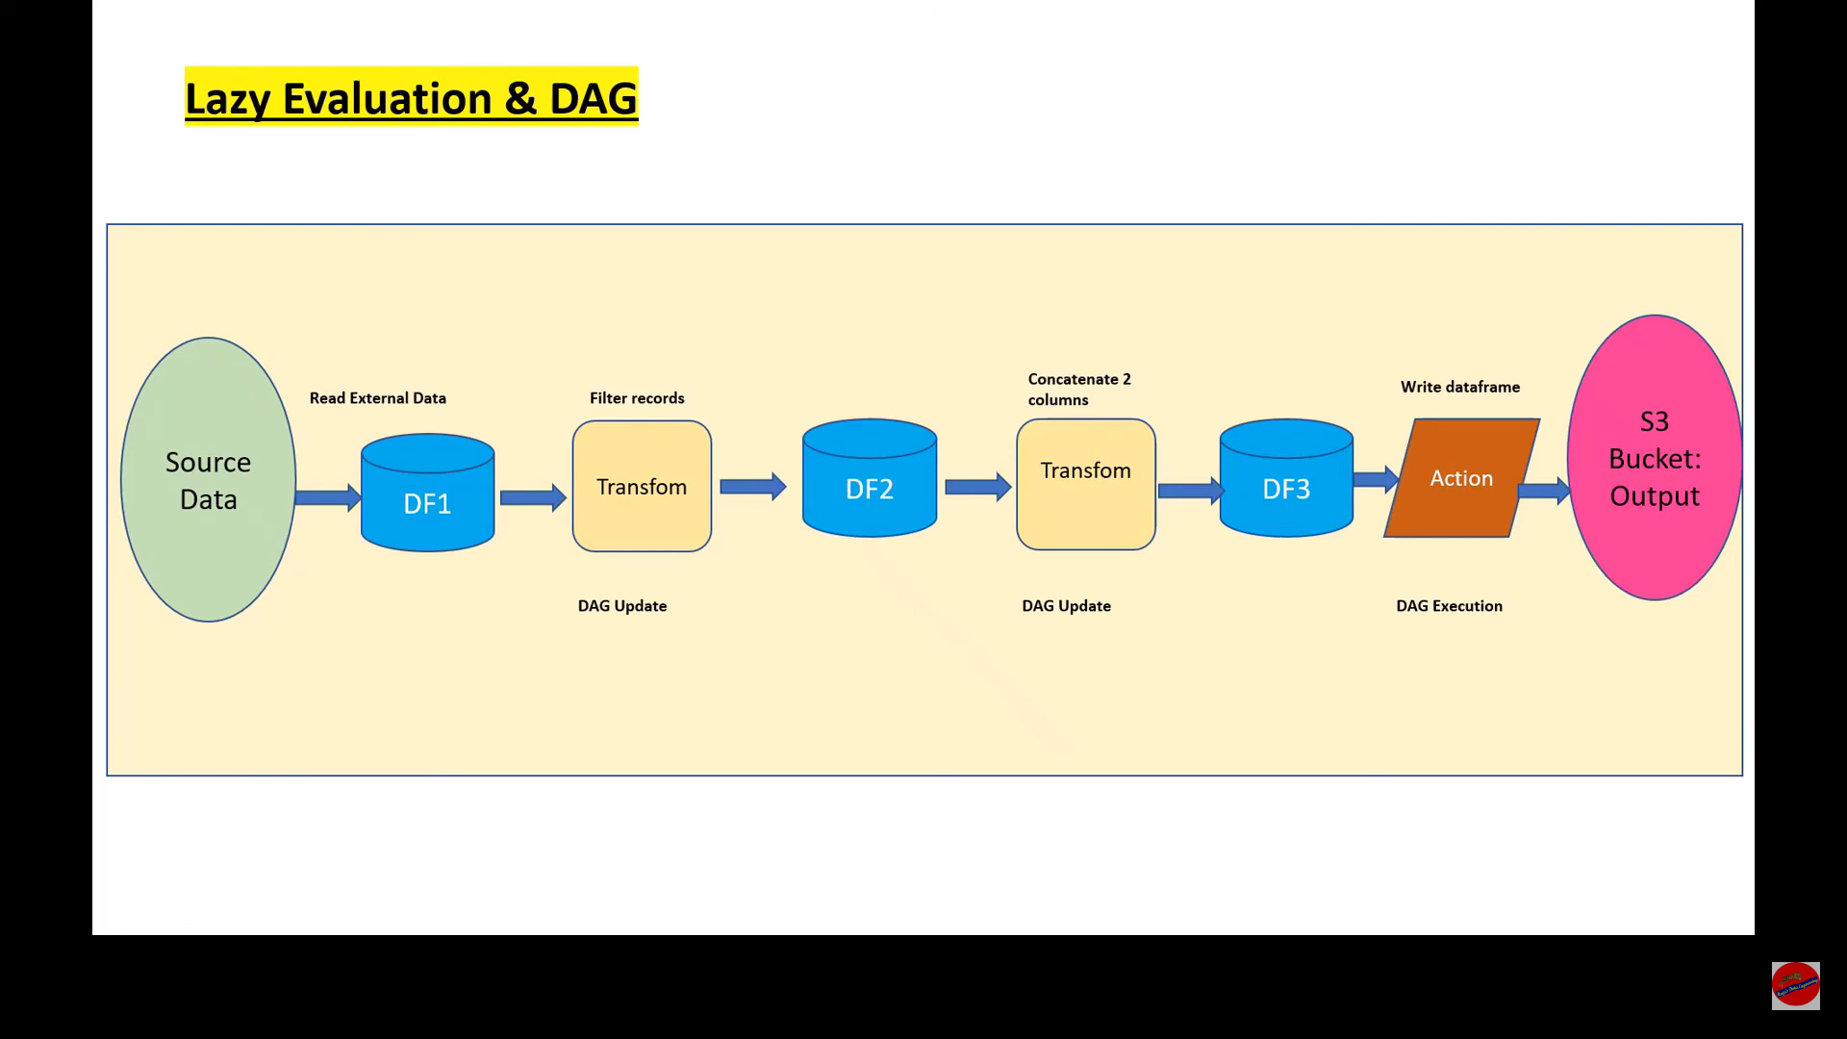

Slide 21
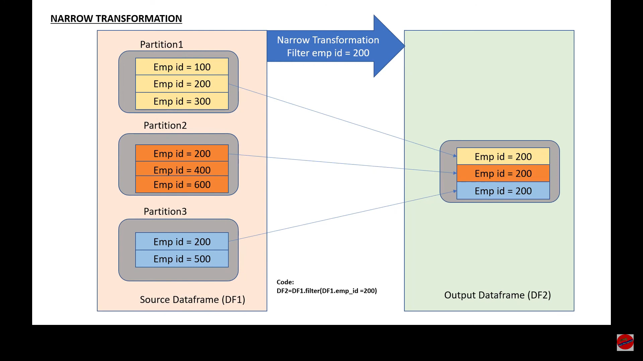

Slide 22
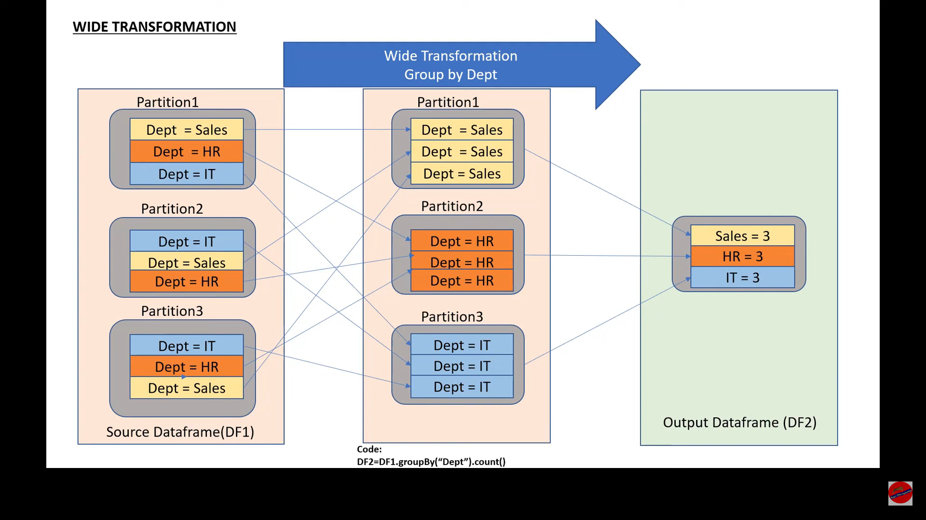

Slide 23
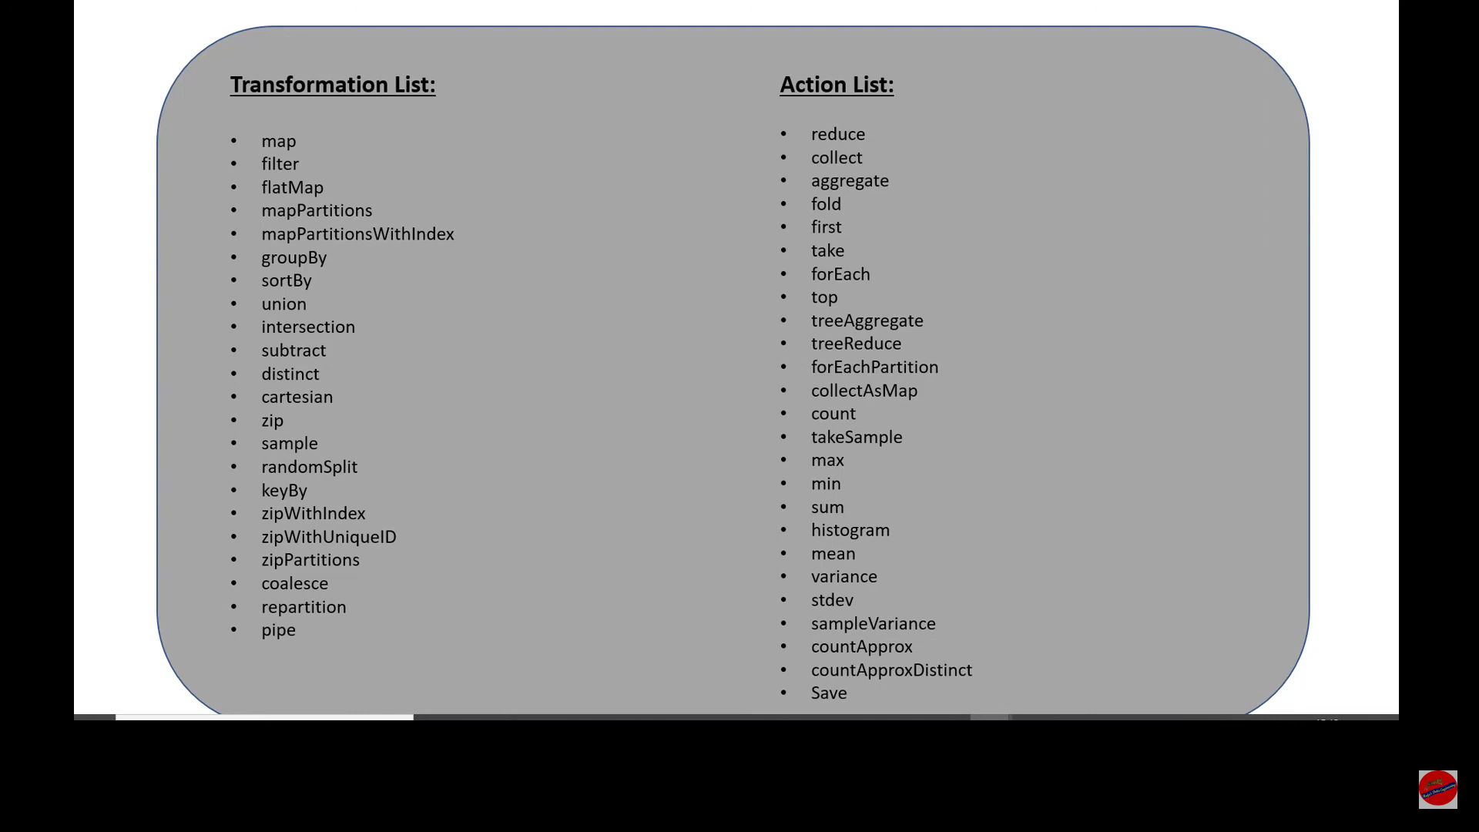

Slide 24
On-Heap vs Off-Heap memory in Databricks

Slide 25
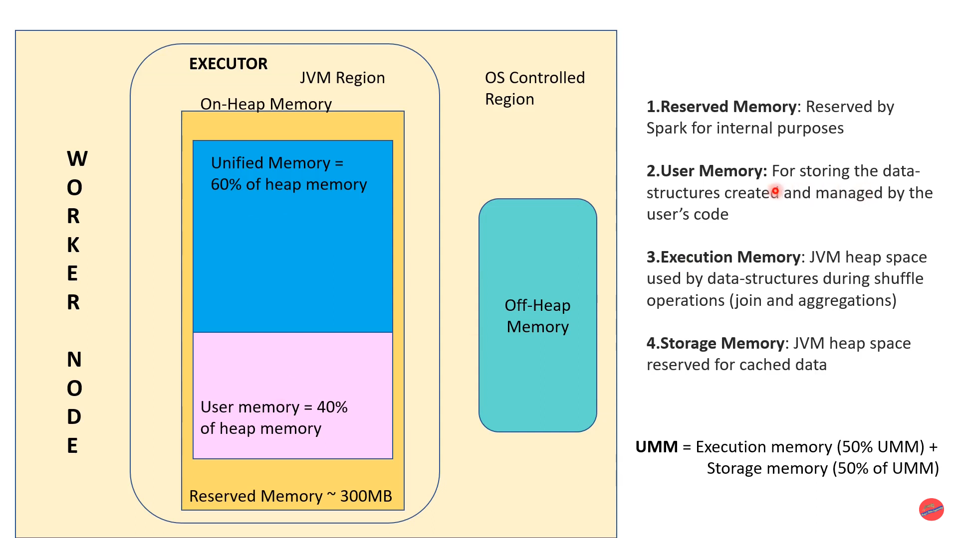


Slide 26
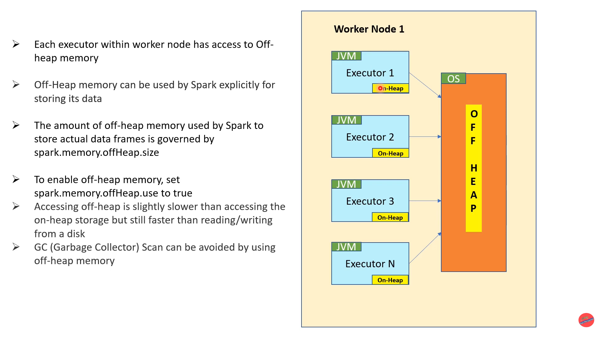


Slide 27
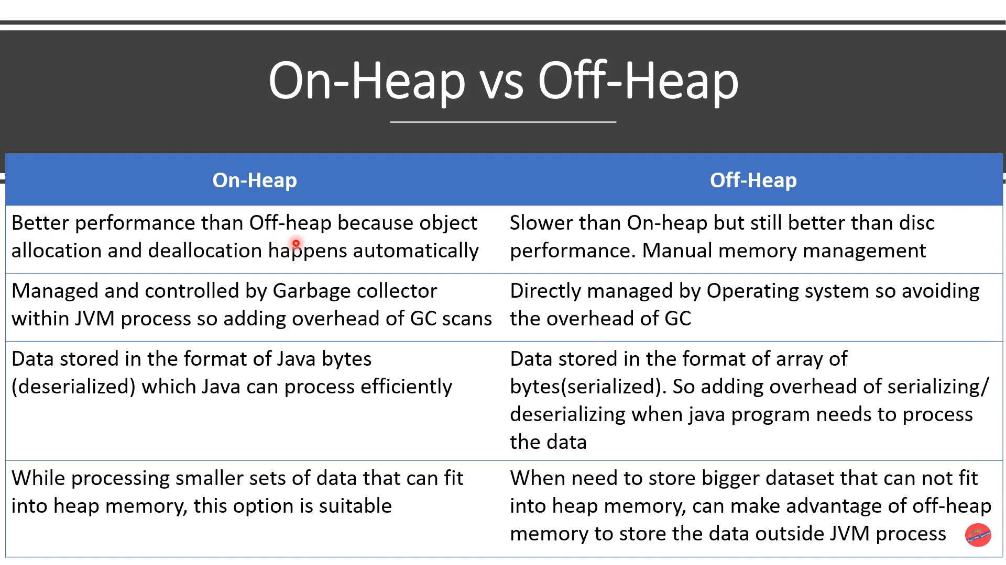


Slide 28
Pyspark: Cluster Deployment

Slide 29
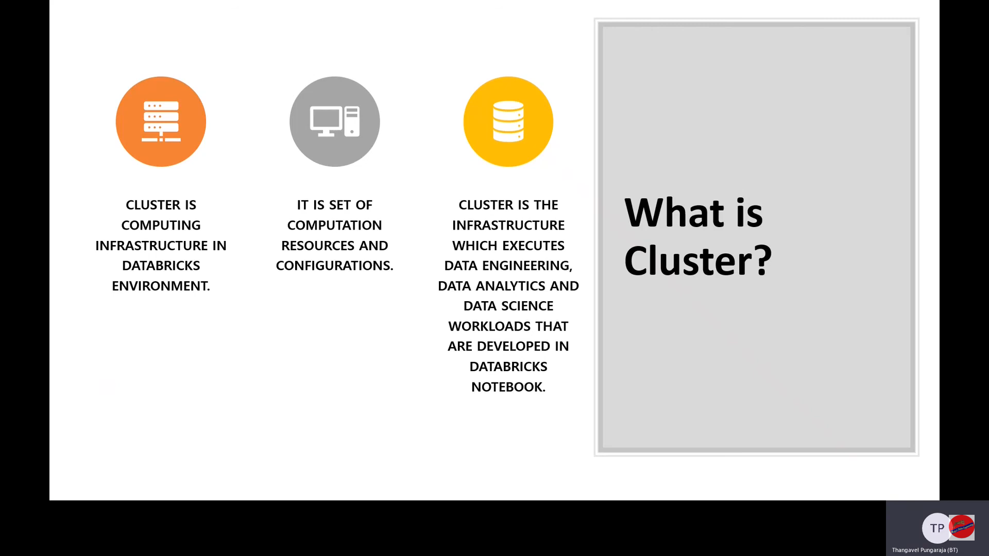

Slide 30
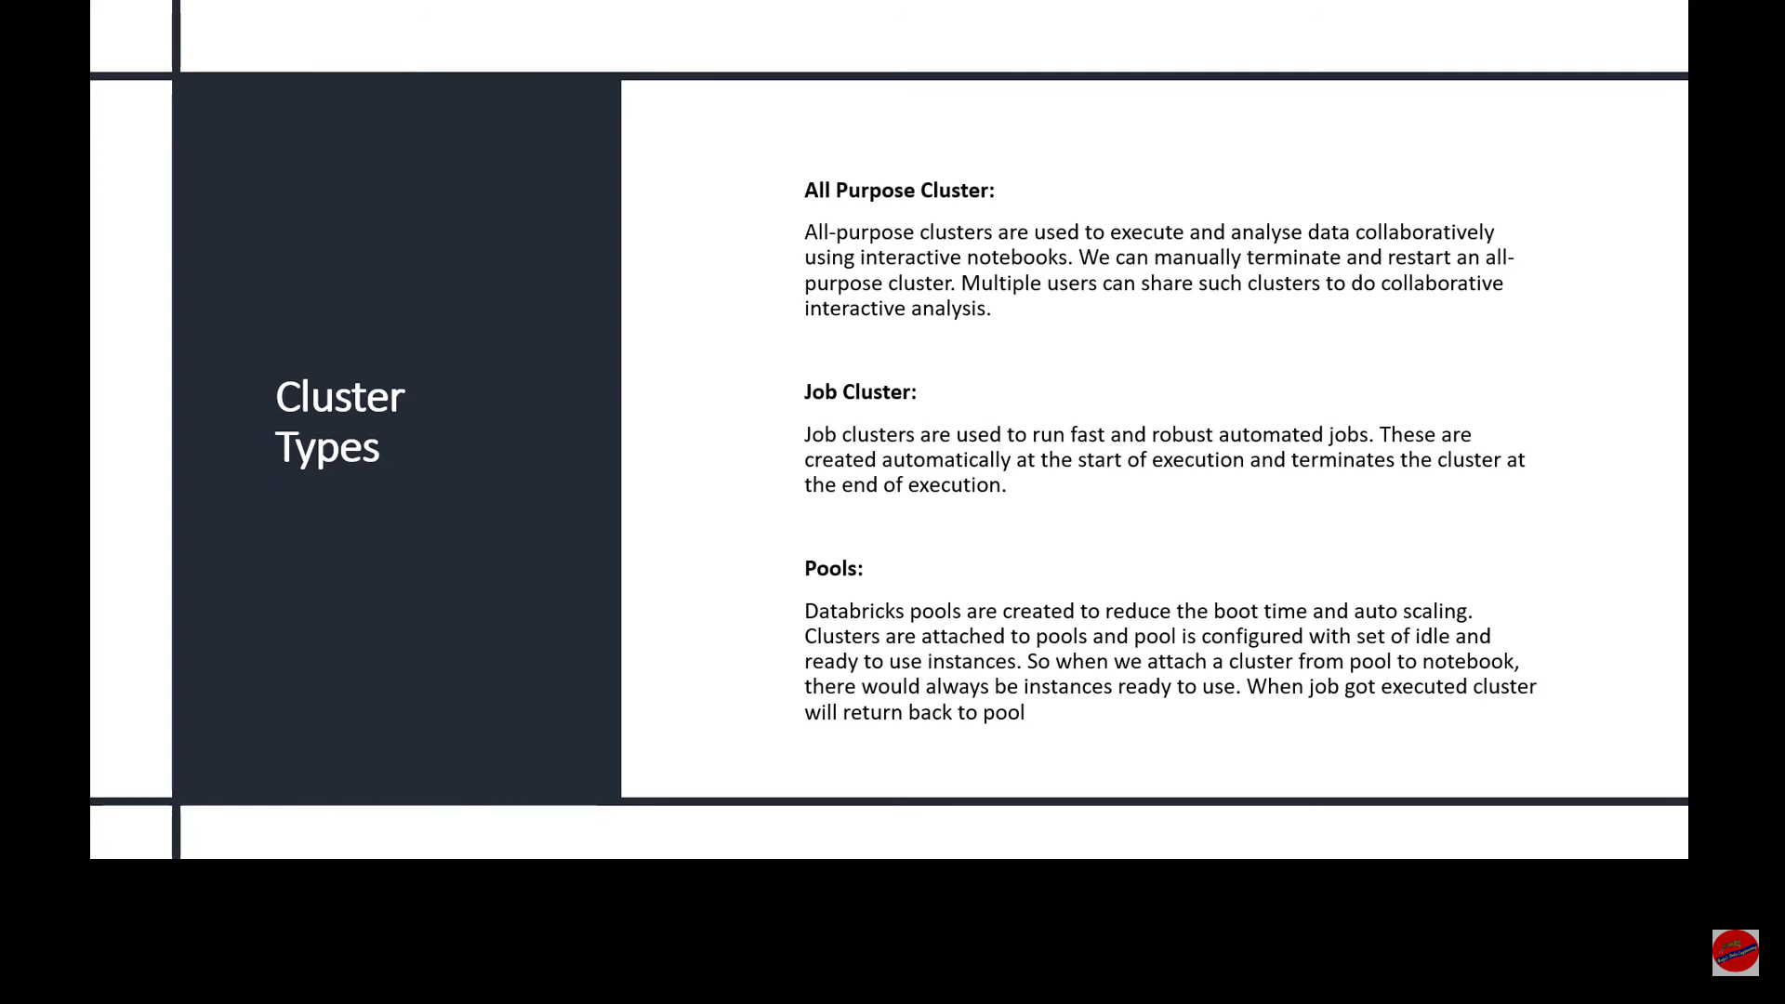


Slide 31
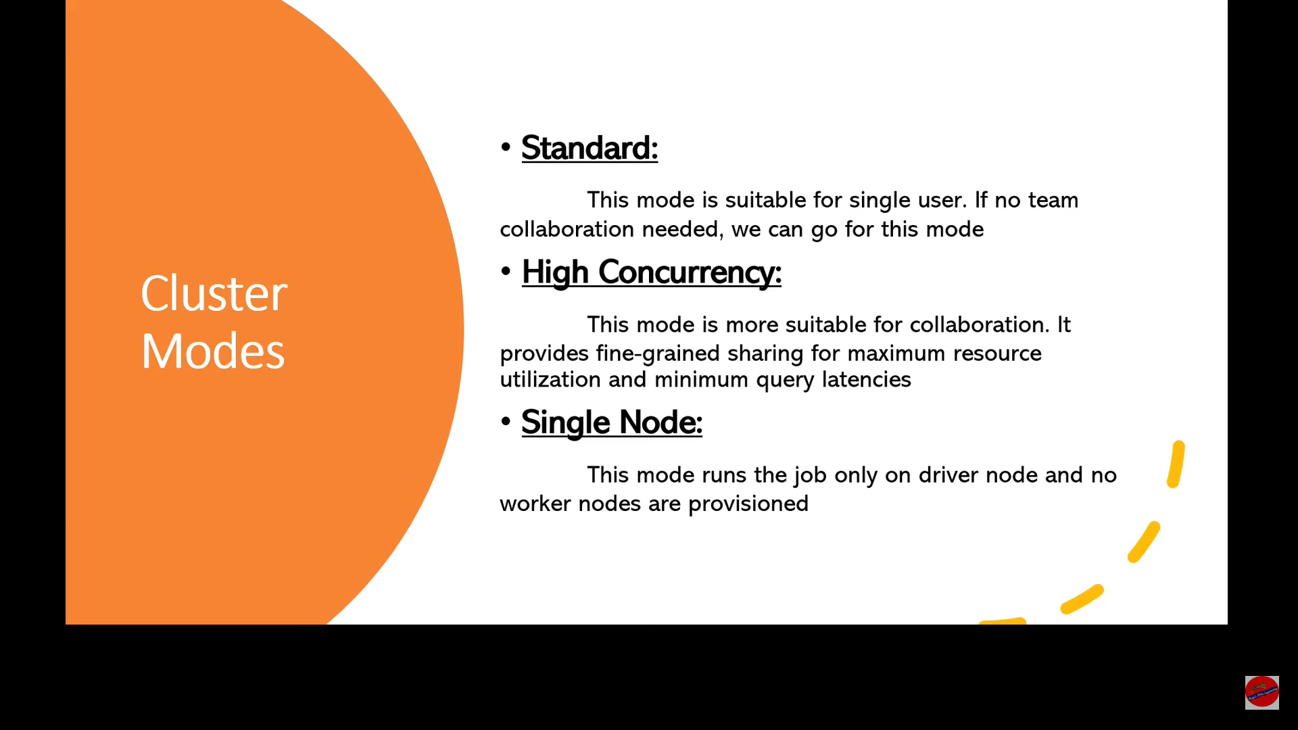


Slide 32
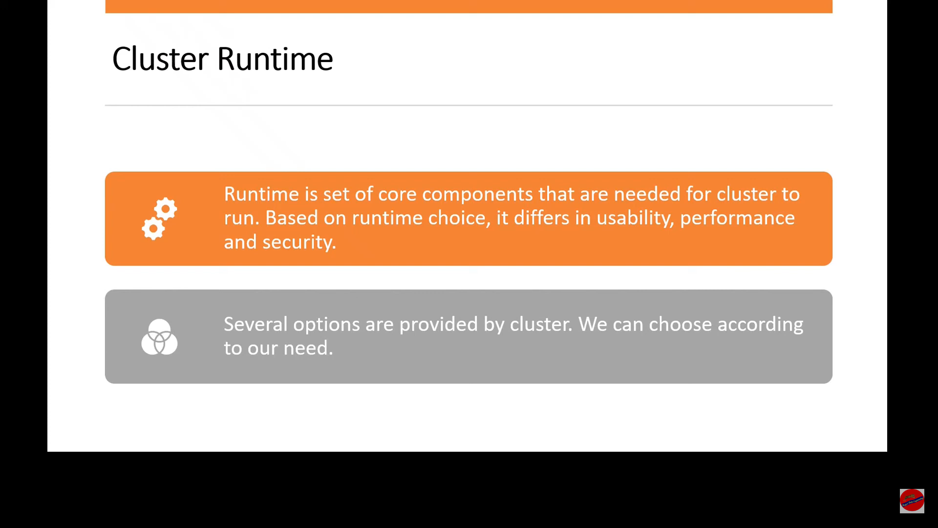


Slide 33
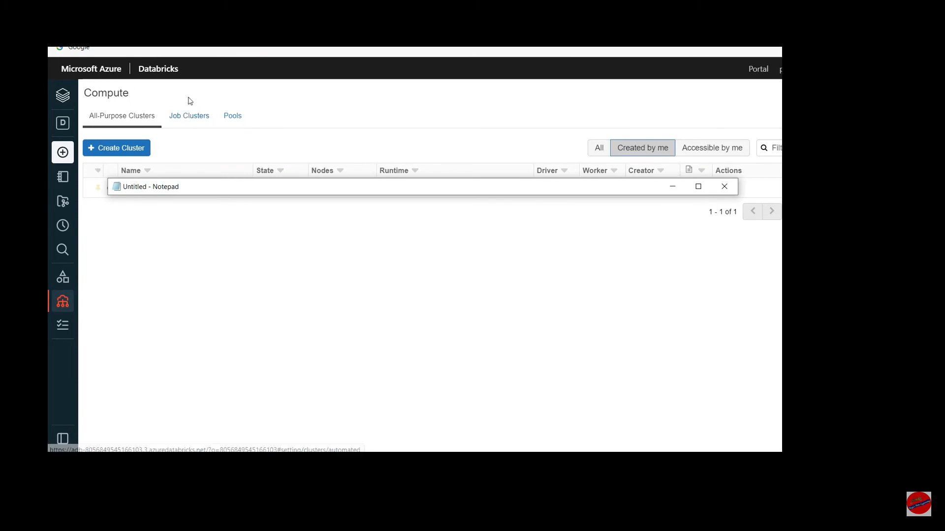

Slide 34
Pyspark: SparkSession vs SparkContext

Slide 35
Since earlier versions of Spark or Pyspark, SparkContext (JavaSparkContext for Java) is an entry point to Spark programming with RDD and to connect to Spark Cluster,
Since Spark 2.0 SparkSession has been introduced and became an entry point to start programming with DataFrame and Dataset.

Slide 36
Spark Reader: Read CSV File

Slide 37
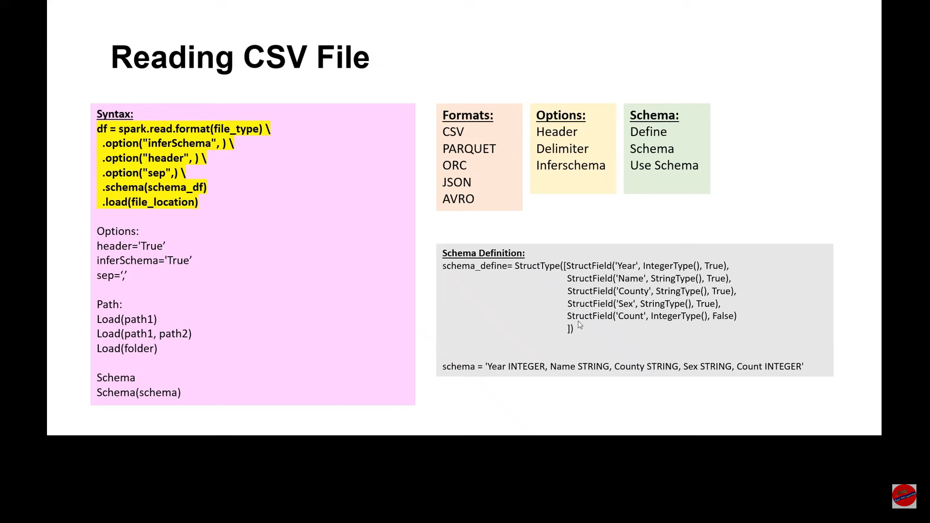

Slide 38
import pyspark
from pyspark.sql import SparkSession
from pyspark.sql.types import StructType,StructField, StringType, IntegerType
spark = SparkSession.builder.master("local[1]").appName('SparkByExamples.com').getOrCreate()
data = [("James","","Smith","36636","M",3000),
("Michael","Rose","","40288","M",4000),
("Robert","","Williams","42114","M",4000),
("Maria","Anne","Jones","39192","F",4000),
("Jen","Mary","Brown","","F",-1)]
schema = StructType([ \
StructField("firstname",StringType(),True), \
StructField("middlename",StringType(),True), \
StructField("lastname",StringType(),True), \
StructField("id", StringType(), True), \
StructField("gender", StringType(), True), \
StructField("salary", IntegerType(), True) ])
df = spark.createDataFrame(data=data,schema=schema)
df.printSchema()
df.show(truncate=False)

Slide 39
Pyspark: Filter Condition

Slide 40
Filter Condition
Starts With
Ends With
Contains
Like
Null values
isin
Single & Multiple Condition

Slide 41
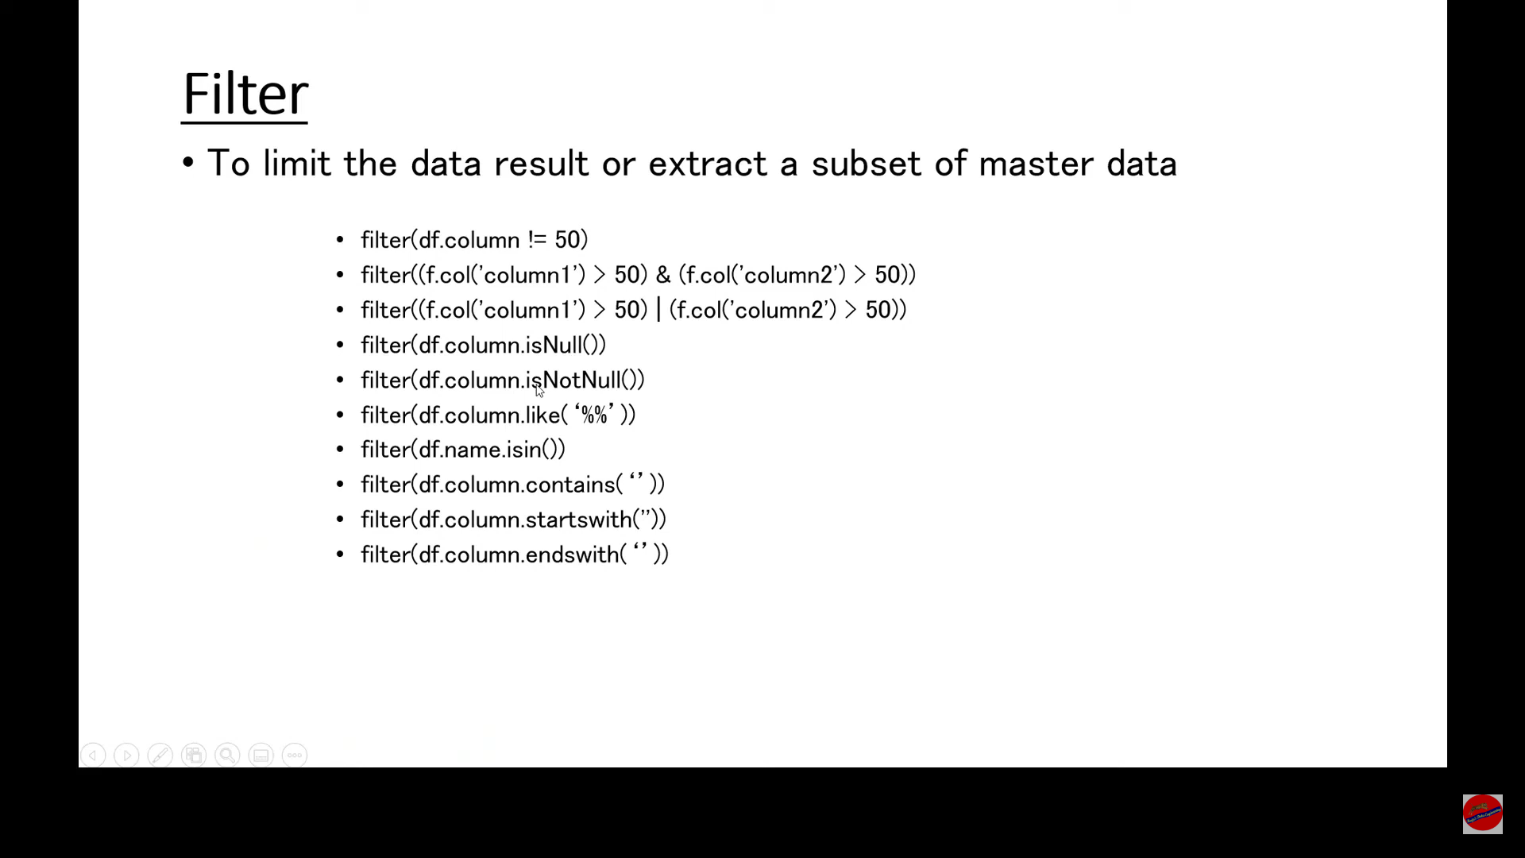

Slide 42
Pyspark: Add, Rename and Drop Columns

Slide 43
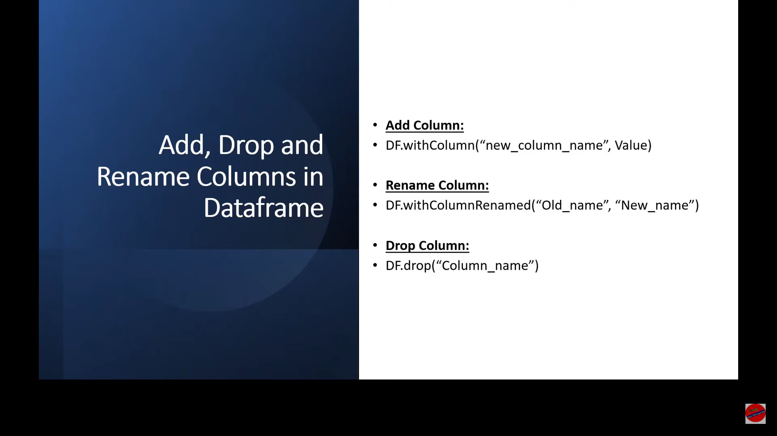

Slide 44
Pyspark: lit vs col

Slide 45
PySpark SQL functions lit() and typedLit() are used to add a new column to DataFrame by assigning a literal or constant value.
col("A") is equivalent to df. A or df["A"] here.

Slide 46
PySpark Join Types

Slide 47
Join Types
LEFT OUTER
RIGHT OUTER
FULL OUTER
LEFT ANTI
LEFT SEMI
INNER
CROSS
SELF

Slide 48
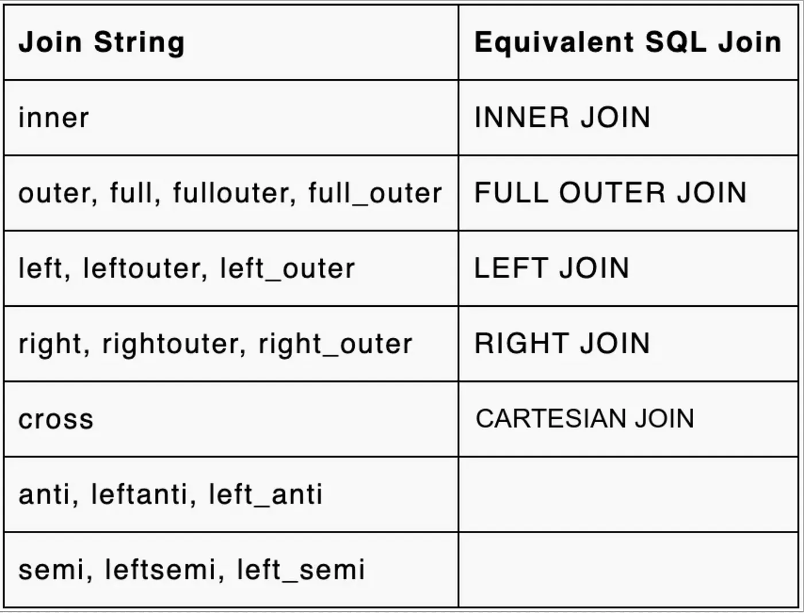
PySpark Join Types

Slide 49
Syntax
df1.join(df2,df1.column_name== df2.column_name,”type”)

Slide 50
Pyspark: Explode Function

Slide 51
What is Explode
It is Pyspark function that returns a new row for each element in the given array or map. Uses the default column name col for elements in the array and key and value for elements in the map.

Slide 52
Variants
Explode - When an array is passed to this function, it creates a new row for each element in array. When a map is passed, it creates two new columns one for key and one for value and each element in map split into the rows. if the array or map is null, that row is eliminated.
Explode_outer - Unlike explode, if the array or map is null, explode_outer returns null.
Posexplode — When array or map is passed, creates positional column also for each element. Ignores the null elements
Posexplode_outer - Unlike posexplode, if the array or map is null, explode_outer returns null.

Slide 53
Pyspark: Case Function (When.Otherwise)

Slide 54
Case Statement
To evaluate list of conditions and choose a result path according to the matching condition, When().Otherwise()
function in Pyspark can be used This is similar to case or switch statement in other programming languages
When no condition is matching, Otherwise result path would be chosen.

Slide 55
Syntax
df.withCoIumn("New or existing column", when(ConditionI, Resultl).when(Condition2, Result2).when(ConditionN, ResultN).otherwise(Result))
df.withColumn("New or existing column, expr(“CASE WHEN conditioni THEN Resulti"+"WHEN condition2 THEN Result2"+"WHEN ConditionN THEN ResultN" +"ELSE Result END"))
To combine multiple conditions: ‘&’ for AND: 'l' for OR

Slide 56
Pyspark: Union & UnionAll

Slide 57
union()
unionAll() deprecated since spark 2.0

Slide 58
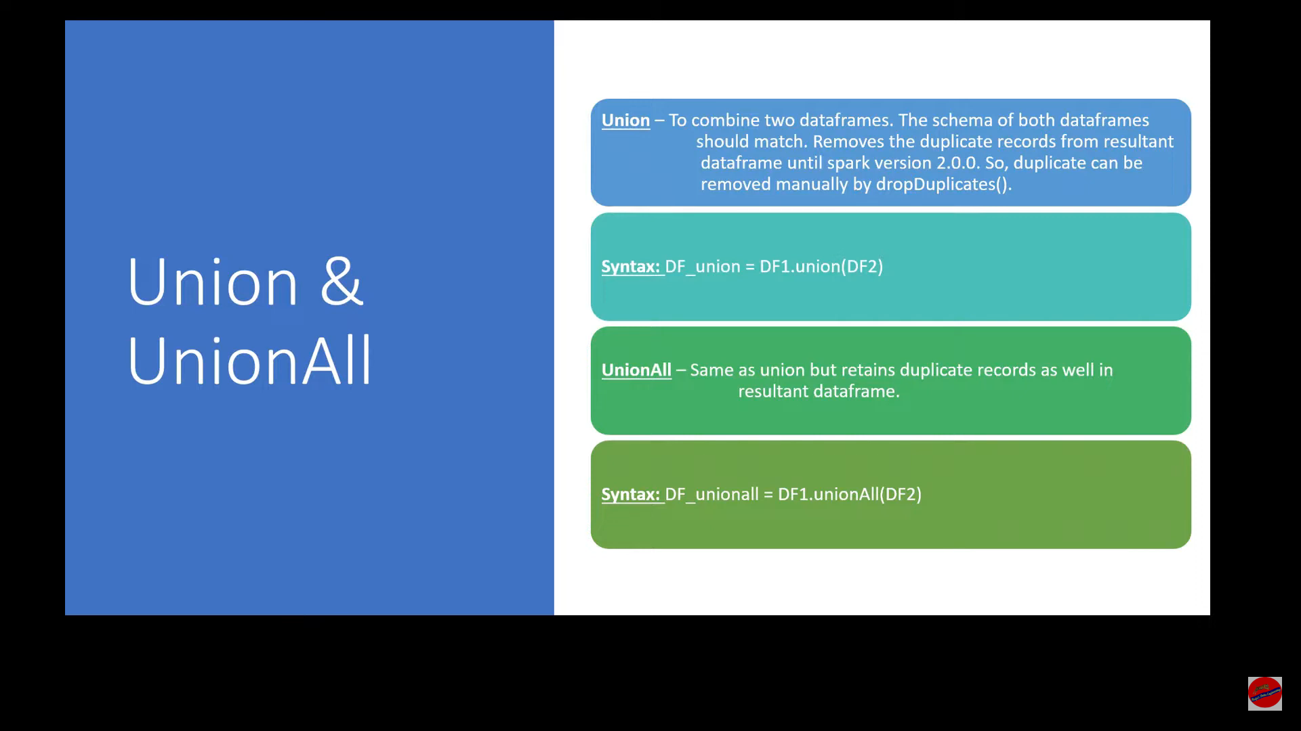


Slide 59
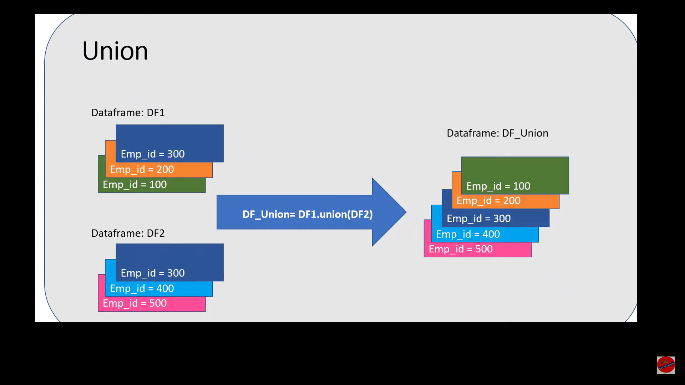


Slide 60
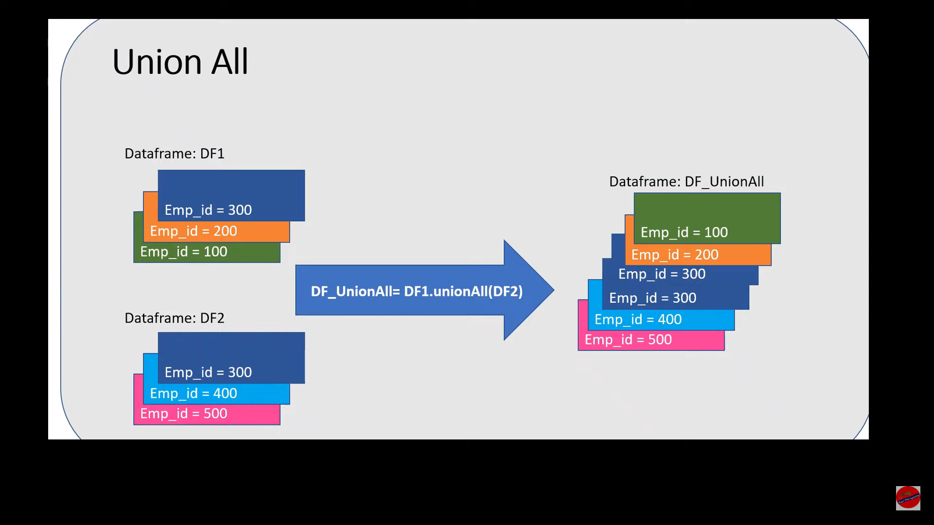


Slide 61
Pyspark: Pivot & Unpivot

Slide 62
Pivot
is use to transpose the list of values of a column to columns.
Unpivot
is quite opposite to pivot i.e. transposing the columns into list of values to a column.

Slide 63
